Slide 1
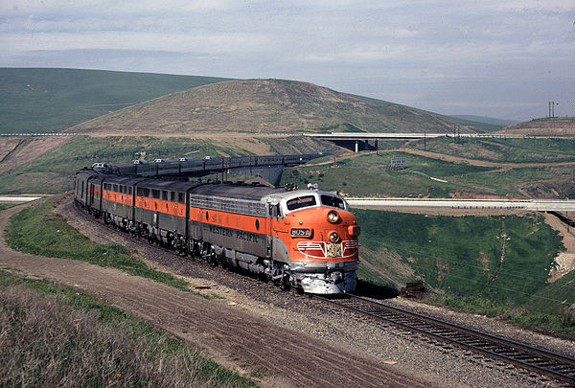
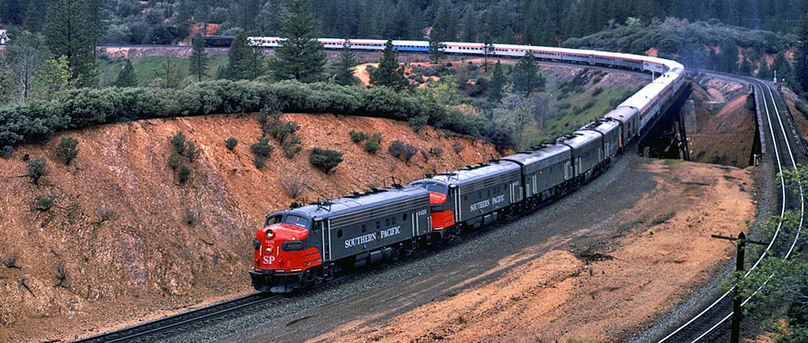
Alameda
County
Central
Railroad
Society
Celebrating the History and Impact of Railroads on Alameda County and California

Slide 2
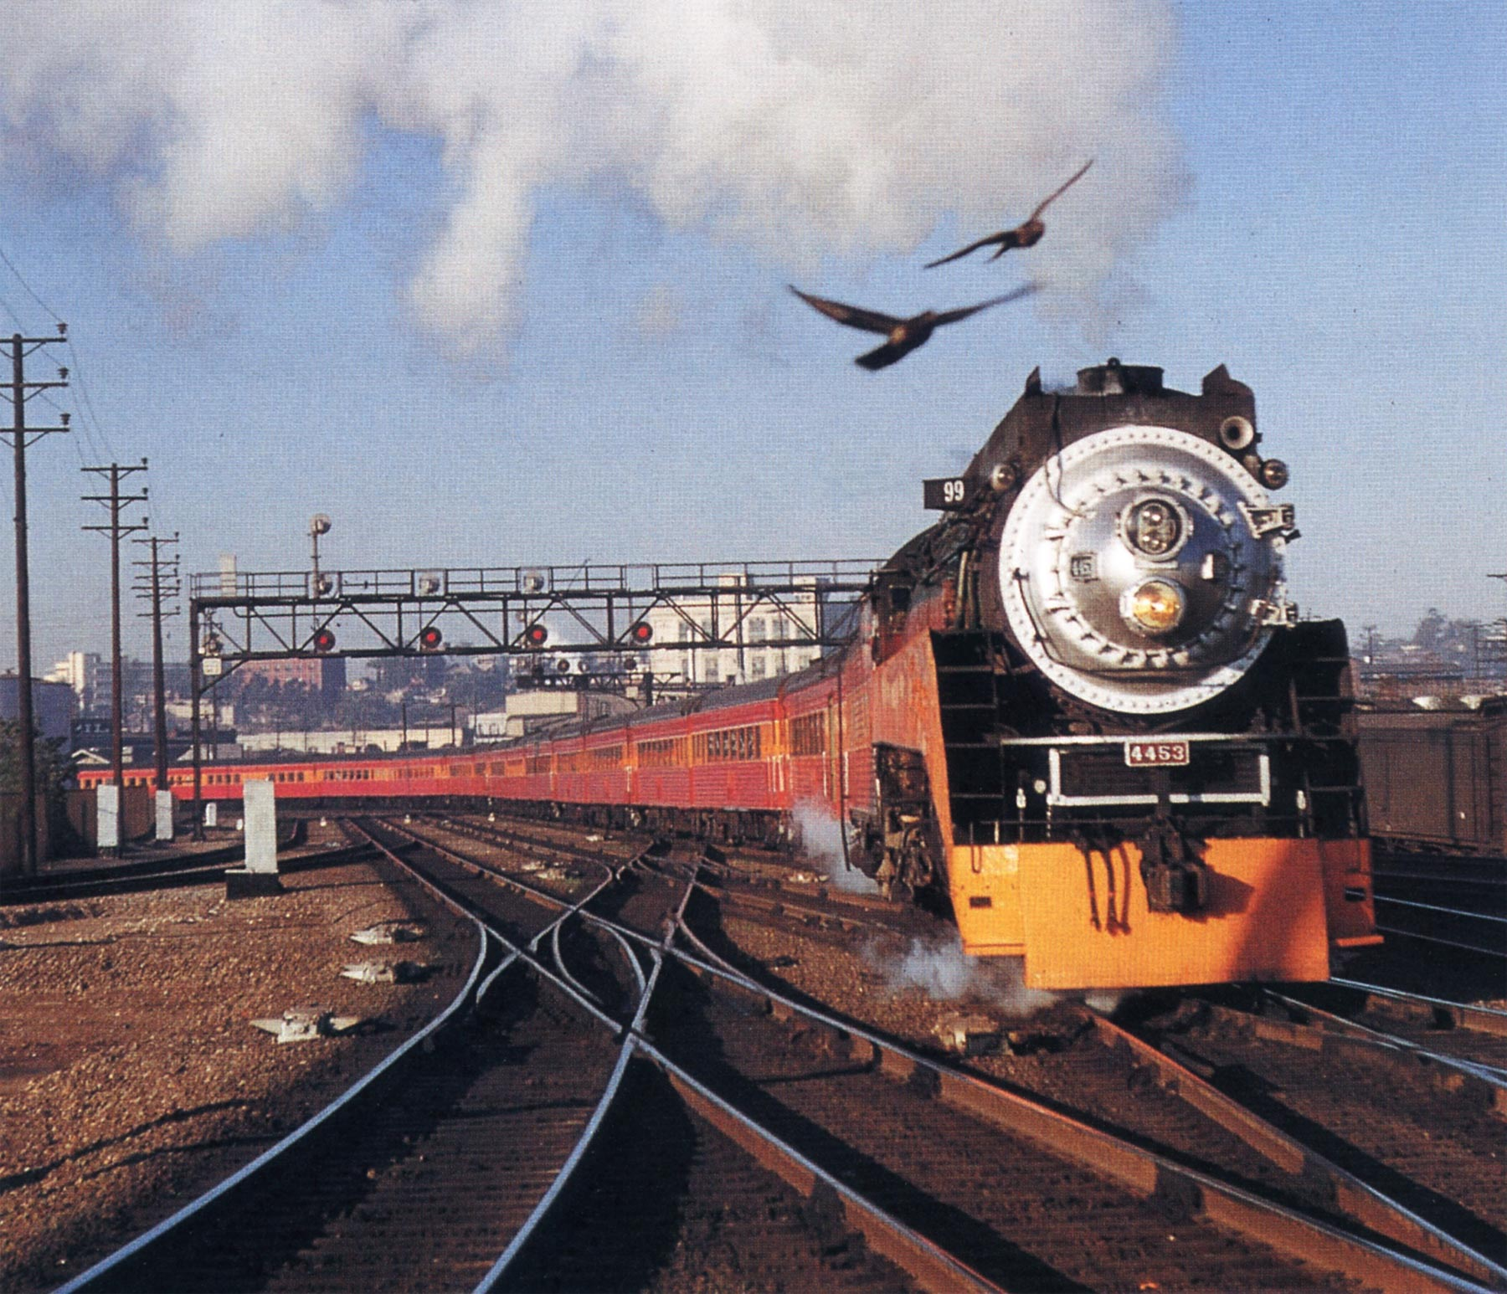
Alameda
Central
Central
Railroad
Society
Celebrating the History and Impact of Railroads on Alameda County and California

Slide 3
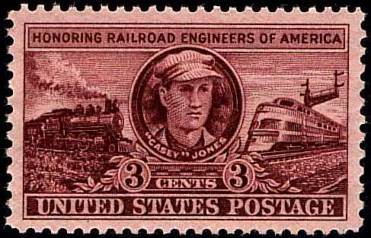
Alameda
County
Central
Railroad
Society

Slide 4
Alameda
County
Central
Railroad Society

Slide 5
Alameda County
Central
Railroad Society

Slide 6
ACCRS
Alameda County Central
Railroad Society

Slide 7
Alameda
County
Central
Railroad
Society

Slide 8
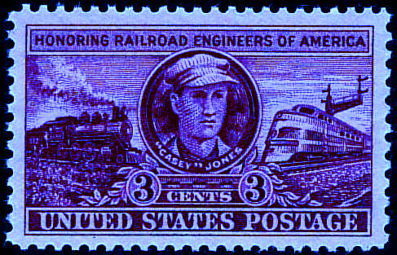
ALAMEDA
COUNTY
CENTRAL
RAILROAD
SOCIETY

Slide 9
ALAMEDA
CENTRAL cOAST
RAILROAD
SOCIETY

Slide 10
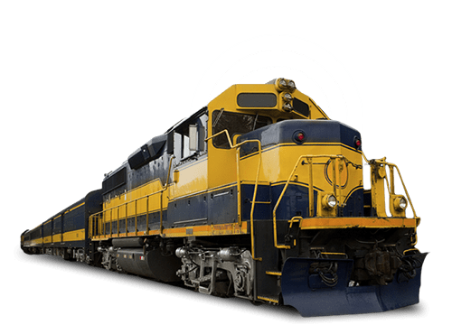
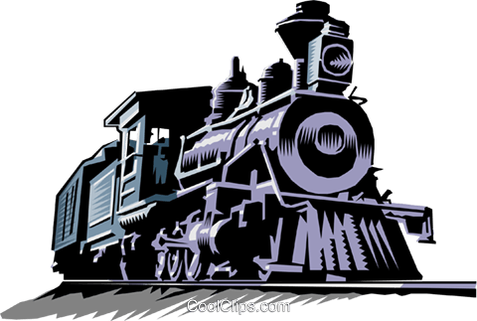
ACCRS
Alameda County Central Railroad Society

Slide 11
ACCRS
Alameda County Central Railroad Society

